Slide 1

Software Development Processes Teaming Pair Programming Introduction to Ruby
Hank Walker
Based on materials from Armando Fox and David Patterson
© 2013 Armando Fox & David Patterson, all rights reserved

Slide 2
Outline
1.2,10.7 SW Development Processes: Plan & Document
1.3 SW Development Processes: Agile Manifesto
1.12 Fallacies and Pitfalls
10.1 It Takes a Team: Two-Pizza and Scrum
10.2 Pair Programming
3.1 Overview & Three Pillars of Ruby
3.2-3.3 Everything is an object, Every operation is a method call
3.4 Ruby OOP (if time permits)

Slide 3



Plan-and-Document Processes: Waterfall vs. Spiral vs. RUP
(Engineering Software as a Service §1.2, §10.7)

Slide 4
How to Avoid SW Infamy?
Can’t we make building software as predictable in schedule and cost and quality as building a bridge?
If so, what kind of development process to make it predictable?

Slide 5
Software Engineering
Bring engineering discipline to SW
Term coined ~20 years after 1st computer
Find SW development methods as predictable in quality, cost, and time as civil engineering
“Plan-and-Document”
Before coding, project manager makes plan
Write detailed documentation for all phases of plan
Progress measured against the plan
Changes to project must be reflected in documentation and possibly to plan

Slide 6
1st Development Process: Waterfall (1970)
5 phases of Waterfall “lifecycle”
Requirements analysis & specification
Architectural design
Implementation & Integration
Verification
Operation & Maintenance
Complete one phase before start next one
Why? Earlier a bug caught, cheaper it is
Extensive documentation/phase for new people
Notes:
Like falling down a waterfall
Lots of planning,
6-12 months or more per step
Often steps done by different people
Throw over the wall
Lots of documentataion in case people leave

Slide 7
How Well Does Waterfall Work?
And the users exclaimed with a laugh and a taunt: “It’s just what we asked for, but not what we want.”
Anonymous
Often when customer sees it, wants changes to SW product
Notes:
May apply to your project
Downside to waterfall?

Slide 8
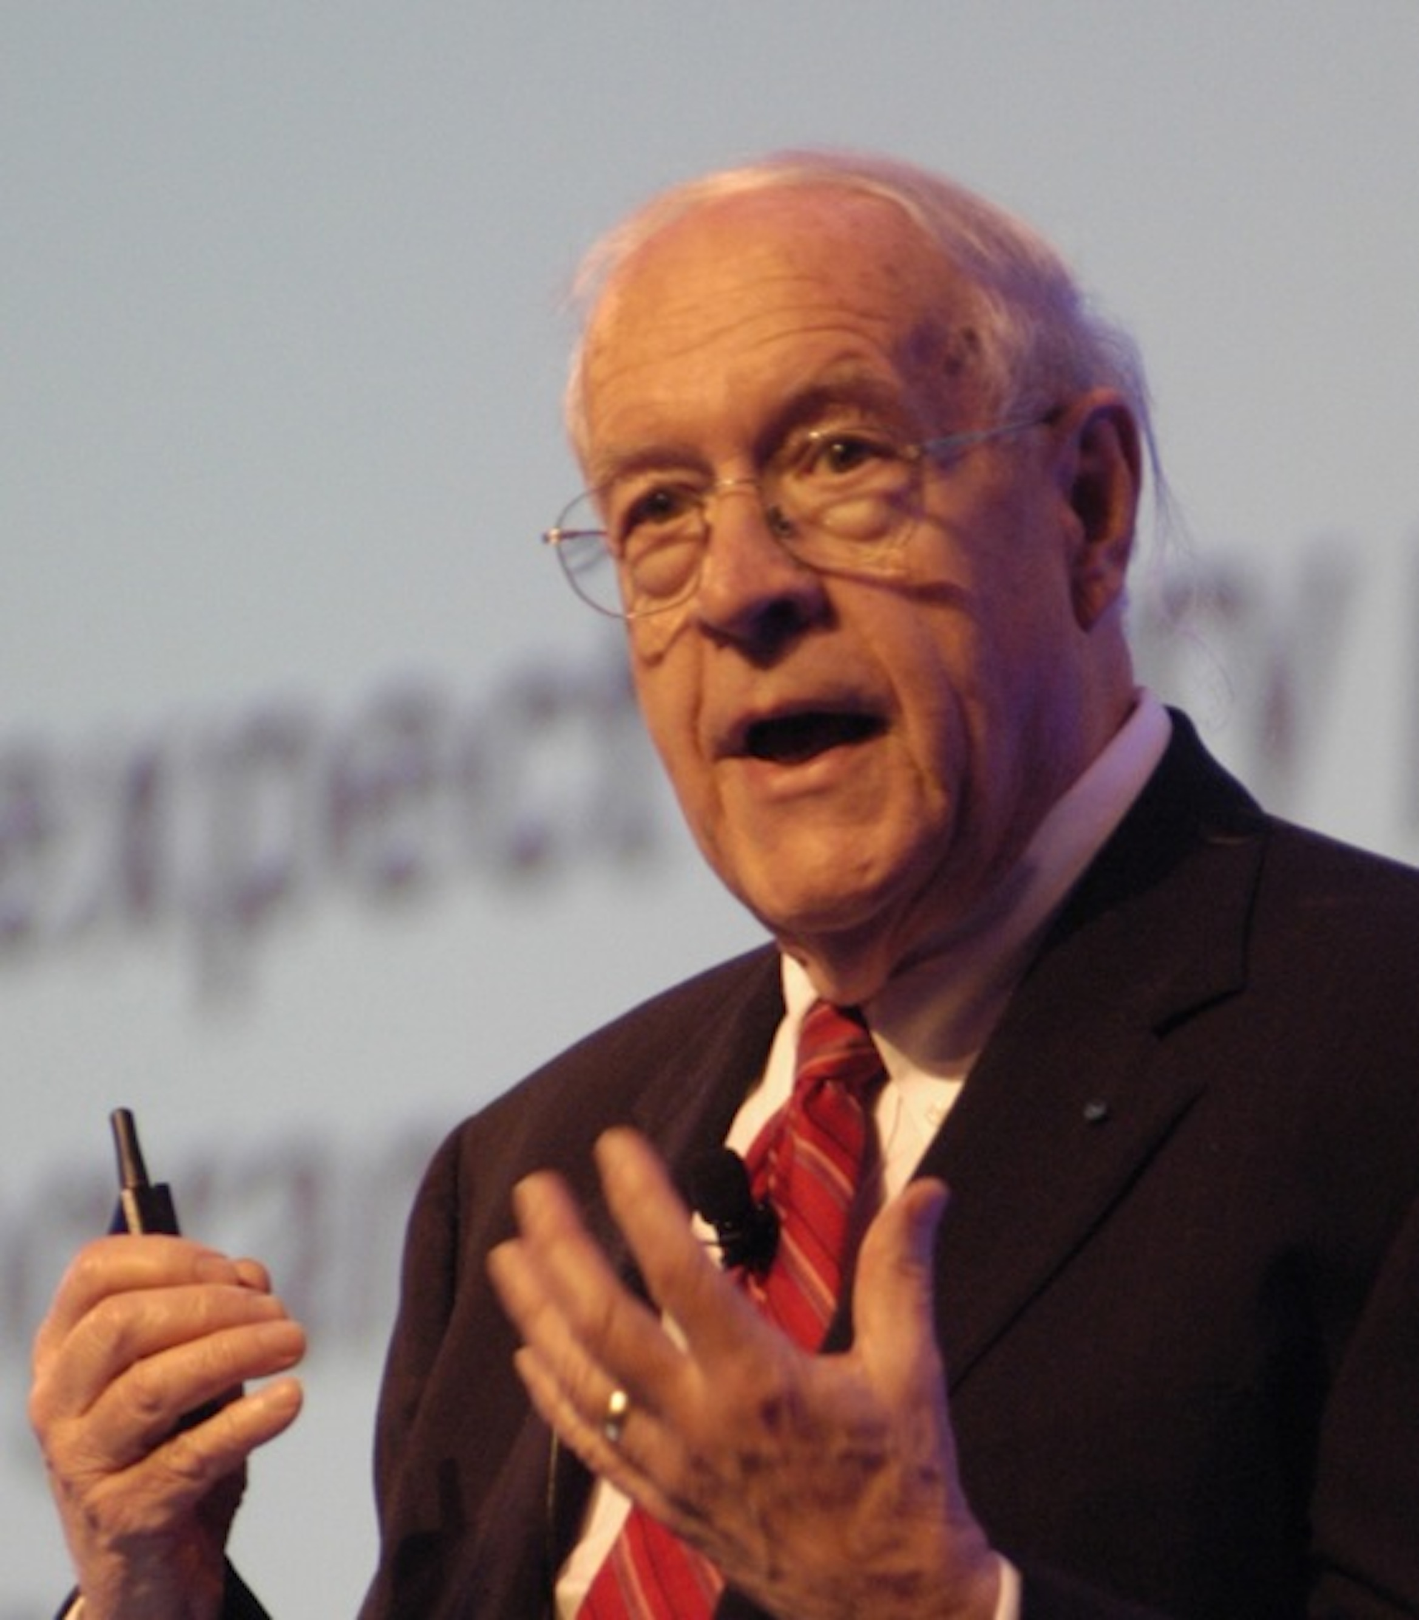
How Well Does Waterfall Work?
“Plan to throw one [implementation] away; you will, anyhow.”
Fred Brooks, Jr. (1999 Turing Award winner)
Often after build first one, developers learn right way they should have built it
(Photo by Carola Lauber of SD&M www.sdm.de. Used by permission under CC-BY-SA-3.0.)
Notes:
May apply to your project
Downside to waterfall?

Slide 9
Spiral Lifecycle (1986)
Combine Plan-and-Document with prototypes
Rather than plan & document all requirements 1st, develop plan & requirement documents across each iteration of prototype as needed and evolve with the project
Notes:
Best track record for safety-critical systems

Slide 10
Spiral Lifecycle
(Figure 1.2, Engineering Long Lasting Software by Armando Fox and David Patterson, 1st edition, 2014.)

Slide 11



Spiral Good & Bad
Iterations involve the customer before the product is completed
Reduces chances of misunderstandings
Risk management part of lifecycle
Project monitoring easy
Schedule & cost more realistic over time
Iterations 6 to 24 mo long
Time for customers to change their minds!
Lots of documentation per iteration
Lots of rules to follow, hard for whole project
Cost of process is high
Hard to meet budget and schedule targets

Slide 12
Rational Unified Process (RUP) Lifecycle (2003)
(Figure 1.3, Engineering Software as a Service by Armando Fox and David Patterson, 1st edition, 2014.)

Slide 13
RUP Phases
4 Phases (can iterate)
Inception: business case, set schedule and budget, risk assessment
Elaboration: use cases, SW archi- tecture, prototype
Construction: codes and tests the product, 1st release
Transition: move to real environment, get customer acceptance

Slide 14
RUP Engineering Disciplines
6 disciplines of people over lifetime of project
Business Modeling
Requirements
Analysis and Design
Implementation
Test
Deployment

Slide 15
RUP Good & Bad
Business practices tied to development process
Lots of tools from Rational (now IBM)
Tools support gradual improvement of project
Tools are expensive (not open source)
So many options to tailor RUP to a company, so do not use all the tools
Only good for medium to large-scale projects
Manager’s set size of iterations to make manageable

Slide 16

P&D Project Manager
P&D depends on Project Managers
Write contract to win the project
Recruit development team
Evaluate software engineers performance, which sets salary
Estimate costs, maintain schedule, evaluate risks & overcomes them
Document project management plan
Gets credit for success or blamed if projects are late or over budget
Notes:
P&D == Plan and Document

Slide 17
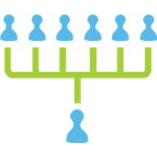
P&D Team Size
“Adding manpower to a late software project makes it later.”
Fred Brooks, Jr., The Mythical Man-Month
It takes time for new people to learn project
Communication time grows with size, leaving less time for work
Groups of 4 to 9 people, but hierarchically composed for larger projects
Notes:
We are using teams of 6 in CSCE 606.

Slide 18
END

Slide 19
Which is FALSE about Waterfall, Spiral, and RUP Lifecycles?
☐
All rely on careful planning, and measure progress against the plan
☐
All rely on thorough documentation
☐
All rely on a manager to be in charge of the project
☐
All use iteration and prototypes
Notes:
True
True
True
False. Waterfall does not use iteration or prototypes, but Spiral and RUP do

Slide 20
END

Slide 21
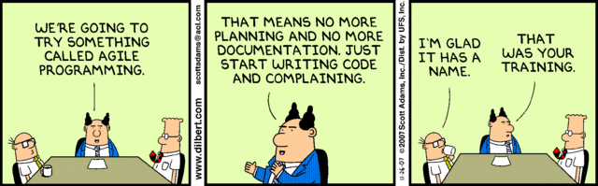
Development Processes: Agile
(Engineering Software as a Service§1.3)

Slide 22
Alternative Process?
How well can Plan-and-Document hit the cost, schedule, & quality target?
P&D requires extensive documentation and planning and depends on an experienced manager
Can we build software effectively without careful planning and documentation?
How to avoid “just hacking”?

Slide 23
How Well does Plan-and-Document Work?
IEEE Spectrum “Software Wall of Shame”
31 projects (4 from last lecture + 27): lost $17B
3X over budget, schedule!
3/~500 new development projects on time and budget!
(Figure 1.4, Engineering Software as a Service by Armando Fox and David Patterson, 1st edition, 2014.)
Notes:
Figure 1.4: The first study of software projects found that 53% of projects exceeding their budgets by a factor of 2.9 and overshot their schedule by a factor of 3.2 and another 31% of software projects were cancelled before completion (Johnson 1995). The an estimated annual cost in the United States for such software projects was $100B. The second survey of 250 large projects, each with the equivalent of more than a million lines of C code, found similarly disappointing results (Jones 2004). The final survey of members of the British Computer Society found that only 130 of 1027 projects met their schedule and budget. Half of all projects were maintenance or data conversion projects and half new development project, but the successful projects divided into 127 of the former and just 3 of the latter (Taylor 2000). Last project Johnson 2013 looked only at $10M+ projects.

Slide 24
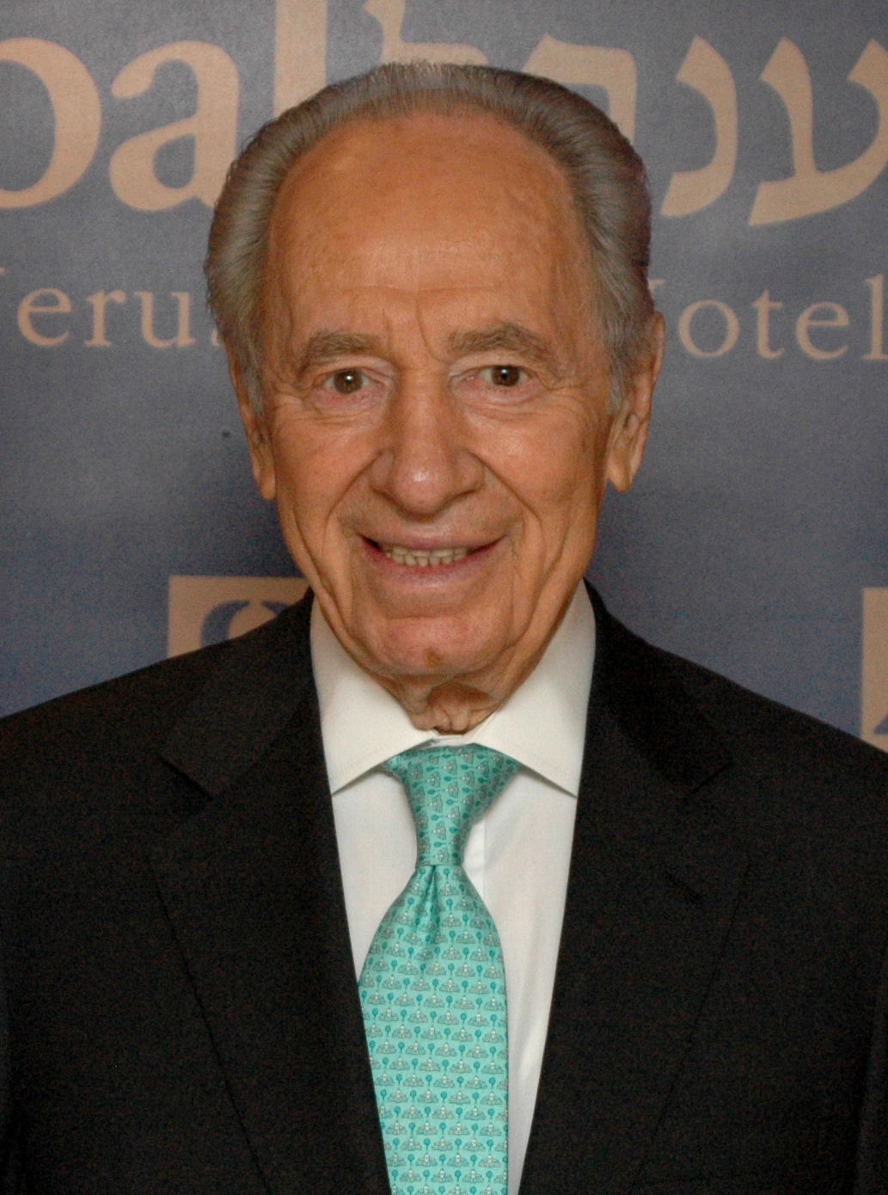
Peres’s Law
“If a problem has no solution, it may not be a problem, but a fact, not to be solved, but to be coped with over time.”
— Shimon Peres
(winner of 1994 Nobel Peace Prize for Oslo accords)
(Photo Source: Michael Thaidigsmann, put in public domain,
See http://en.wikipedia.org/wiki/File:Shimon_peres_wjc_90126.jpg)

Slide 25
Agile Manifesto, 2001
“We are uncovering better ways of developing SW by doing it and helping others do it. Through this work we have come to value:
Individuals and interactions over processes & tools
Working software over comprehensive documentation
Customer collaboration over contract negotiation
Responding to change over following a plan
That is, while there is value in the items on the right, we value the items on the left more.”
Notes:
Just over 10 years – lots
4 theses
Like Martin Luther nailed his Ninety-Five Theses on 31 October 1517 to the door of the Catholic Church, sparking the Reformation movement in Christianity
Change is not a problem to be solved, but a fact to be coped with

Slide 26
“Extreme Programming” (XP) Version of Agile Lifecycle
If short iterations are good, make them as short as possible (weeks vs. years)
If simplicity is good, always do the simplest thing that could possibly work
If testing is good, test all the time - write the test code before you write the code to test
If code reviews are good, review code continuously, by programming in pairs, taking turns looking over each other’s shoulders

Slide 27
Agile Lifecycle
Embraces change as a fact of life: continuous improvement vs. phases
Developers continuously refine working but incomplete prototype until customers happy, with customer feedback on each Iteration (every ~1 to 2 weeks)
Agile emphasizes Test-Driven Development (TDD) to reduce mistakes, written down User Stories to validate customer requirements, Velocity to measure progress
Notes:
Working but incomplete
More iterations, the more you’ll learn
Write Tests before writing code
Customer helps write SW requirements

Slide 28

Agile Iteration/Book Organization
Book Part I: SaaS (2-6)
Book Part II: Agile (7-12)
(Figure 1.9, Engineering Software as a Service by Armando Fox and David Patterson, 1st edition, 2014.)
Notes:
2 phases of Tests first

Slide 29
Agile Then and Now
Controversial in 2001
“… yet another attempt to undermine the discipline of software engineering… nothing more than an attempt to legitimize hacker behavior.”
Steven Ratkin, “Manifesto Elicits Cynicism,”
IEEE Computer, 2001
Accepted in 2013
2012 study of 66 projects found majority using Agile, even for distributed teams

Slide 30
Yes: Plan-and-Document No: Agile
1. Is specification required?
2. Are customers unavailable?
3. Is the system to be built large?
4. Is the system to be built complex (e.g., real time)?
5. Will it have a long product lifetime?
6. Are you using poor software tools?
7. Is the project team geographically distributed?
8. Is team part of a documentation-oriented culture?
9. Does the team have poor programming skills?
10. Is the system to be built subject to regulation?
(Sommerville, 2011)

Slide 31
END

Slide 32
Which is TRUE?
☐
A big difference between Agile and P&D is that Agile does not use requirements
☐
A big difference between Agile and P&D is measuring progress against a plan
☐
You can build SaaS apps using Agile, but not with Plan-and-Document
☐
A big difference between Agile and P&D is building prototypes and interacting with customers during the process
Notes:
Sort of False. While Agile does not develop extensive requirements documents as does Waterfall/Spiral/RUP, the interactions with customers lead to the creation of requirements as user stories, as we shall see in Chapter 7.
True. Agile measures velocity rather than progress against a plan.
False. You can use both lifecycles to build a SaaS app.
Sort of False. True for Waterfall, but Spiral and RUP have prototypes and iterate with the customer.

Slide 33
END

Slide 34

Fallacies and Pitfalls, Chapter 1 Summary
(Engineering Software as a Service§§1.12, 1.13)

Slide 35
Fallacies and Pitfalls
Fallacy: The Agile lifecycle is best for software development
Good match for some SW, especially SaaS
But not for NASA, code subject to regulations
Per topic, will practice Agile way to learn but will also see Plan & Document perspective
Note: you will see new lifecycles in response to new opportunities in your career, so expect to learn new ones
Notes:
Fallacy – sounds true, but false
Pitfall – know it might happen, but it happens anyways
If behind, throw stuff out

Slide 36
Fallacies and Pitfalls
Pitfall: Ignoring the cost of software design
Since ≈0 cost to manufacture software, might believe ≈0 cost to remanufacture the way the customer wants
Ignores the cost of design and test
(Is cost ~no cost of manufacturing software/data same rationale to pirate data? No one should pay for development, just for manufacturing?)
Notes:
Same philosophy

Slide 37
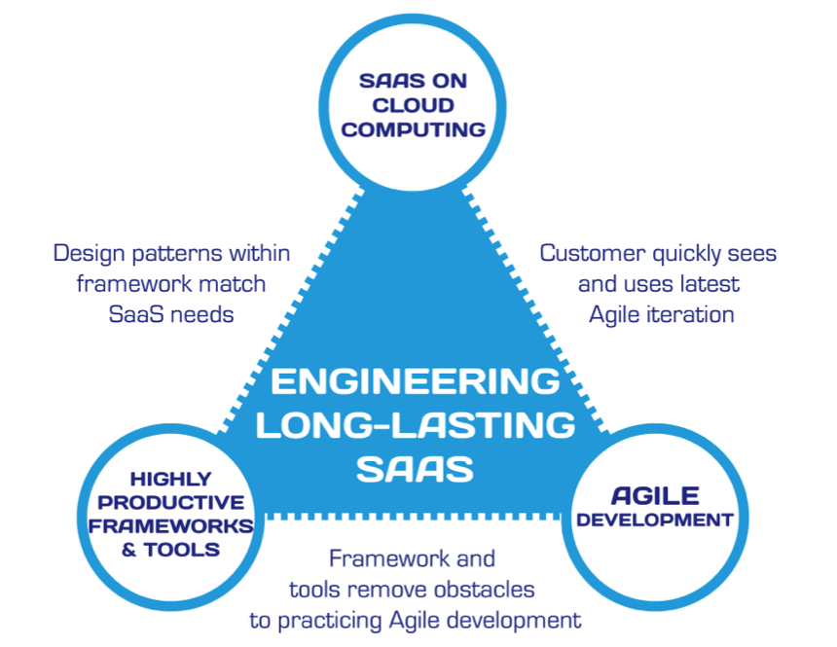
Summary: Engineering SW is More Than Programming
(Figure 1.11, Engineering Software as as Service by Armando Fox and David Patterson, 1st edition, 2014.)
Notes:
Virtuous triangle: 3 jewels that course is based on
Top: SaaS revolutionize SW, depends on Cloud
Right: Agile, invented independent of other jewels, just a great match
Left: Ruby independent but Rails created to do Agile
Chain between the jewels:
Cloud & Agile: deployed on cloud so customers sees every 2 weeks
Cloud & Frameworks: frameworks have design within framework that matches SaaS needs
Tools & Agile: Not preaching, but tools to implement Agile principles - TDD

Slide 38
END

Slide 39


It Takes a Team: Size & Scrum
(Engineering Software as a Service §10.1)
© 2012 David Patterson & David Patterson
Licensed under Creative Commons Attribution-NonCommercial-ShareAlike 3.0 Unported License

Slide 40

SW Engineering Now a Team Sport
Now in Post-Superhero- Programmer Era
Rising bar of functionality/quality => cannot do SW breakthrough alone
Successful SW career => programming chops AND plays well with others AND can help make team win
“There are no winners on a losing team, and no losers on a winning team.”
Fred Brooks, Jr.
Notes:
Roommate and colleague Gary Tarolli at DEC (later founded 3dfx) could write 1000 lines of *debugged* code per day, day in and day out.
No longer individuals building amazing things – Linus Torvald leads open source around Linux, but not done by himself
Early – bar was low
Not that many superheroes
What does team need to win (do you need to do more than your part)

Slide 41
Alternative Team Organization?
Plan-and-document require extensive documentation and planning and depends on an experienced manager
How should we organize an Agile team?
Is there an alternative to a hierarchical organization with one manager who runs the project?

Slide 42

Scrum: Team Organization
“2 Pizza” team size (4 to 9 people)
“Scrum” inspired by frequent short meetings
15 minutes every day at same place and time
To learn more: Agile Software Development with Scrum by Schwaber & Beedle
Notes:
Bezos, lots of companies, (2 pizza teams in more people)
Need a way to self-organize
Scrum – penalty
Standup Meeting
What happens at meeting – go

Slide 43

Daily Scrum Agenda
Answers 3 questions at “daily scrums”:
What have you done since yesterday?
What are you planning to do today?
Are there any impediments or stumbling blocks?
Help individuals by identifying what they need
Notes:
Go around in a circle
By understanding what each team member was doing, the team can identify work that would help others make more rapid progress
This would unblock me if you would do this first
Most is common sense

Slide 44

Scrum Roles
Team: 2-pizza size team that delivers SW
Scrum Master: team member who:
Acts as buffer between the Team and external distractions
Keeps team focused on task at hand
Enforces team rules (coding standard)
Removes impediments that prevent team from making progress
Notes:
Not the manager – SM is supposed to be the buffer so team can concentrate

Slide 45
Scrum Roles (cont’d)
Product Owner: A team member (not the Scrum Master) who represents the voice of the customer and prioritizes user stories
Notes:
Team member, not the scrum master, represents customer at daily scrums
Also prioritizes user stories

Slide 46
Resolving Conflicts
E.g. Different views on right technical direction
1st list all items on which the sides agree
vs. starting with list of disagreements
Discover closer together than they realize?
Each side articulates the other’s arguments, even if don’t agree with some
Avoids confusion about terms or assumptions, which may be real cause of conflict

Slide 47
Resolving Conflicts
Constructive confrontation (Intel)
If you have a strong opinion that a person is proposing the wrong thing technically, you are obligated to bring it up, even to your bosses
Disagree and commit (Intel)
Once decision made, need to embrace it and move ahead
“I disagree, but I am going to help even if I don’t agree.”
Conflict resolution useful in personal life!

Slide 48

Scrum Summary
Basically, self-organizing small team with daily short standup meetings
Work in “sprints” of 2-4 weeks
Suggest members rotate through roles (especially Product Owner) each iteration
Notes:
Only 2 roles
Instead of iterations, do sprints when ready
Help if each take turns
Pivotal Labs actually puts customer at PL comes to the daily scrums

Slide 49
END

Slide 50
Which is TRUE Regarding Teams?
☐
As compared to Scrum, P&D project managers act as both Scrum Master and Product Owner
☐
Teams should try to avoid conflicts at all costs
☐
P&D can have much larger teams than does Scrum, which report directly to the project manager
☐
As studies show 84%-90% projects are on-time and on-budget, P&D managers can promise customers a set of features for an agreed upon cost by an agreed upon date
Notes:
1. True.
2. False. While conflicts need to be resolved, they can be helpful in finding the best path forward for a project.
3. False. While teams can be larger, each team is 2-pizza sized, and composed as a hierarchy (2 level management)
4. False. – 84% to 90% project are late and/or over budget

Slide 51
END

Slide 52
Pair Programming
(Engineering Software as a Service §10.2)
© 2012 David Patterson & David Patterson
Licensed under Creative Commons Attribution-NonCommercial-ShareAlike 3.0 Unported License
Notes:
University is a chance to make mistakes at university

Slide 53
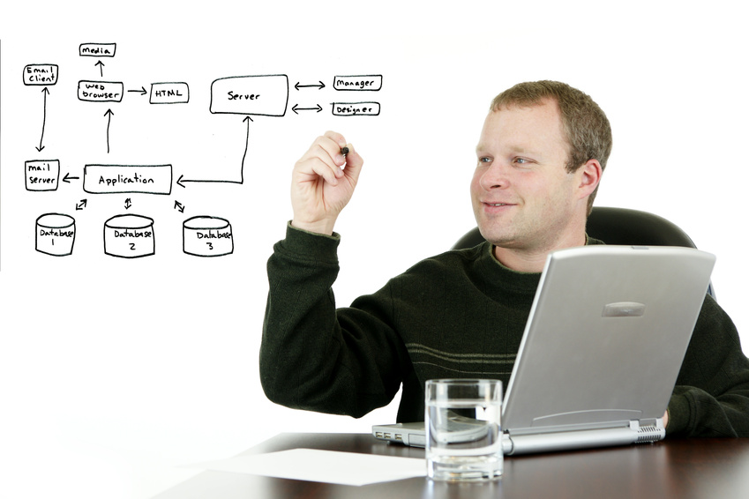
Are 2 minds better than 1?
Stereotypical programmer is lone wolf working all night alone drinking Red Bull
Is there a more social way to program?
What would be the benefits of multiple people programming together?
How would you prevent one person from doing all the work while the other gets coffee and checks Facebook?

Slide 54
Pair Programming
Goal: improve software quality, reduce time to completion by having 2 people develop the same code
Why? Reading code best way to find bugs
Some people (and companies) love it
Try with friends to see if you do
Some students in the past have loved it and used for projects

Slide 55
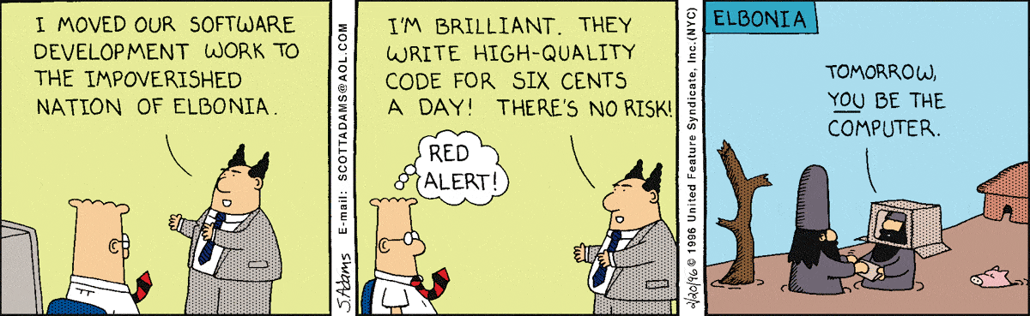
NO!

Slide 56

NO!

Slide 57
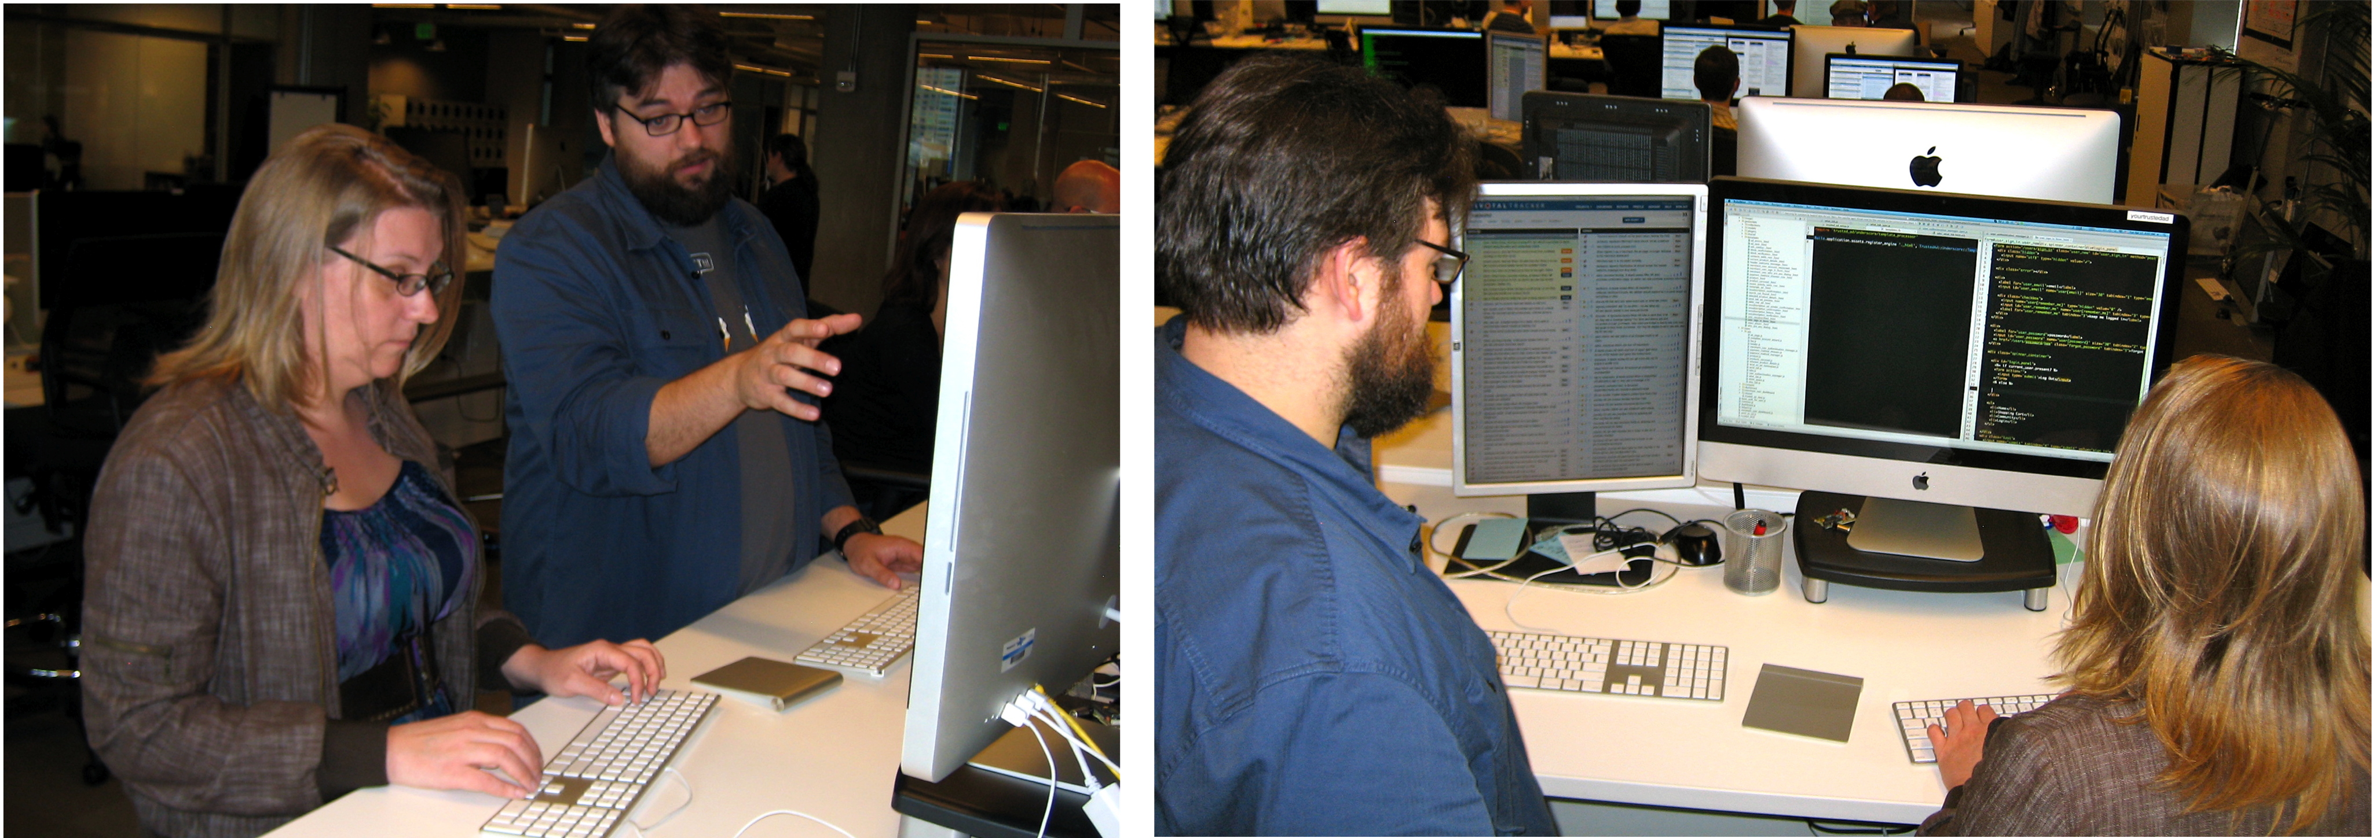
Pair Programming
Sit side-by-side facing screens together
Not personal computer; many for any pair to use
To avoid distractions, no email, browser
Notes:
Sarah Mei and JR Boyens at Pivotal Labs
We know that MultiTasking is distracting, so these are real workstations with no facebook, email, twitter, …
Don’t check email between 8AM and 5PM
Productivity improves
New employees say tired after 8 hours
Go home at night and don’t do programming at home
SV Management technique is buying dinner

Slide 58
Pair Programming
Driver enters code and thinks tactically about how to complete the current task, explaining thoughts while typing
Observer reviews each line of code as typed in, and acts as safety net for the driver
Observer thinking strategically about future problems, makes suggestions to driver
Should be lots of talking and concentration
Pair alternate roles
Notes:
Talking out loud while work (like surgeon on TV)
Driver short term, Observer long term
Have to Alternatve

Slide 59
Pair Programming Evaluation
PP quicker when task complexity is low
PP yields higher quality when complexity high
Anecdotally, sometimes more readable code too
But more effort than solo programmers?
Also transfers knowledge between pair
programming idioms, tool tricks, company processes, latest technologies, …
Some teams purposely swap partners per task => eventually everyone is paired (“promiscuous pairing”)
Notes:
But Pivotal Labs denies it
More senior and more junior
“promiscuous pairing”
Does it factor in distraction

Slide 60
Pair Programming Do’s & Don’ts
Don’t fiddle with your smartphone when you are the observer
Do consider pairing with someone of different experience level—you’ll both learn!
Explaining is a great way to better understand
Do swap frequently—learning goes both ways, and roles exercise different skills
Observer gains skill of explaining his/her thought process to Driver
Every 15 minutes?
Notes:
Concentrate on task at hand (not phone)
Great if mismatch to learn

Slide 61
END

Slide 62
Which TRUE of Pair Programming?
☐
Pair programming is quicker, better quality, cheaper, and less effort than solo programming
☐
The Driver works on tasks at hand, the Observer thinks strategically about future tasks
☐
A pair will eventually figure out who is the best driver and who is the best observer, and then stick primarily to those roles
☐
Promiscuous pairing is one long-term solution to the problem of a shortage of programmers
Notes:
1 False. While quicker, While there have not been careful experiments that would satisfy human subject experts, the current consensus is that pair programming is more expensive—more programmer hours per tasks—than solo programming.
2. True.
3. False. An effective pair will alternate between the two roles, as it’s more beneficial (and more fun) for the individuals to both drive and observe
4. False. Trying to be funny.

Slide 63
END

Slide 64

Overview & Intro to Ruby for Java Programmers
(Engineering Software as a Service §3.1)
© 2013 Armando Fox & David Patterson, all rights reserved

Slide 65
Ruby is...
Interpreted
Object-oriented
Everything is an object
Every operation is a method call on some object
Dynamically typed: objects have types, but variables don’t
Dynamic
add, modify code at runtime (metaprogramming)
ask objects about themselves (reflection)
in a sense all programming is metaprogramming
Notes:
reflection and metaprogramming often used together
it's always runtime, so ALL programming is metaprogramming – even loading a class causes code to be executed.

Slide 66
Naming Conventions
ClassNames use UpperCamelCase
class FriendFinder ... end
methods & variables use snake_case
def learn_conventions ... end
def faculty_member? ... end
def charge_credit_card! ... end
CONSTANTS (scoped) & $GLOBALS (not scoped)
TEST_MODE = true $TEST_MODE = true
symbols: like immutable string whose value is itself
favorite_framework = :rails
:rails.to_s() == "rails"
"rails".to_sym() == :rails
:rails == "rails" # => false
Notes:
Symbols usually connote "specialness". One use is like an Enum in Java.

Slide 67
Variables, Arrays, Hashes
There are no declarations!
local variables must be assigned before use
instance & class variables ==nil until assigned
OK: x = 3; x = 'foo'
Wrong: Integer x=3
Array: x = [1,'two',:three] x[1] == 'two' ; x.length==3
Hash: w = {'a'=>1, :b=>[2, 3]} w[:b][0] == 2 w.keys == ['a', :b]
Notes:
Note, Array and hash elements can be anything, including other arrays/hashes, and don't all have to be same type. As in python and perl, hashes are the Swiss army chainsaw of building data structures.

Slide 68
Methods
Everything (except fixnums) is pass-by-reference
def foo(x,y)
return [x,y+1]
end
def foo(x,y=0) # y is optional, 0 if omitted
[x,y+1] # last exp returned as result
end
def foo(x,y=0) ; [x,y+1] ; end
Call with: a,b = foo(x,y) or a,b = foo(x) when optional arg used
Notes:
Fixnum – integer values small enough to fit into a machine word, always passed by value

Slide 69
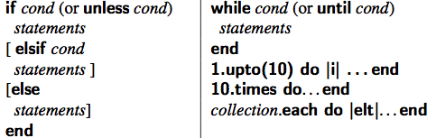
Basic Constructs
Statements end with ';' or newline, but can span line if parsing is unambiguous
✔raise("Boom!") unless ✖ raise("Boom!") ship_stable unless (ship_stable)
Basic Comparisons & Booleans: == != < > =~ !~ true false nil
The usual control flow constructs
Notes:
http://www.tutorialspoint.com/ruby/ruby_operators.htm
=~ true if patterns match
!~ false if patterns match

Slide 70
Strings & Regular Expressions (try rubular.com for your regex needs!)
"string", %Q{string}, 'string', %q{string}
a=41 ; "The answer is #{a+1}"
match a string against a regexp:
"fox@berkeley.EDU" =~ /(.*)@(.*)\.edu$/i
/(.*)@(.*)\.edu$/i =~ "fox@berkeley.EDU"
If no match, value is false
If match, value is non-false, and $1...$n capture parenthesized groups ($1 == 'fox', $2 == 'berkeley')
/(.*)$/i or %r{(.*)$}i or Regexp.new('(.*)$', Regexp::IGNORECASE)
A real example...
http://pastebin.com/hXk3JG8m
Notes:
Single quotes – no string interpolation, like a string constant
Double quotes – do string interpolation, e.g. variable substitution
/i is case insensitive
@variablename is an instance variable
@@variablename is a class variable

Slide 71
END

Slide 72
rx = {:fox=>/^arm/, 'fox'=>[%r{AN(DO)$}, /an(do)/i]}
Which Expression Will Evaluate to Non-nil?
☐
"armando" =~ rx{:fox}
☐
rx[:fox][1] =~ "ARMANDO"
☐
rx['fox'][1] =~ "ARMANDO"
☐
"armando" =~ rx['fox', 1]
Notes:
nil. There is no element rx{:fox}. You need to use brackets, not braces.
nil. There is no element rx[:fox][1]. The :fox key has only one element.
Non-nil. /an(do)/i matches, and returns “do” in $1.
nil. There is no element rx[‘fox’, 1], since the key is not two-dimensional.

Slide 73
END

Slide 74
Everything is an Object, Every Operation is a Method Call
(Engineering Software as a Service §3.2-3.3)
© 2013 Armando Fox & David Patterson, all rights reserved

Slide 75
Modern OO Languages
Objects
Attributes (properties), getters & setters
Methods
Operator overloading
Interfaces
“Boxing” and “unboxing” primitive types
…is there a smaller set of mechanisms that captures most or all of these?

Slide 76
Everything is an Object; (Almost) Everything is a Method Call
Even lowly integers and nil are true objects:
57.methods
57.heinz_varieties
nil.respond_to?(:to_s)
Rewrite each of these as calls to send:
Example: my_str.length => my_str.send(:length)
1 + 2
my_array[4]
my_array[3] = "foo"
if (x == 3) ....
my_func(z)
In particular, things like “implicit conversion” on comparison is not in the type system, but in the instance methods
1.send(:+, 2)
my_array.send(:[], 4)
my_array.send(:[]=, 3,"foo")
if (x.send(:==, 3)) ...
self.send(:my_func, z)
Notes:
Send – send a method (argument to send, in form of symbol) to an object, potentially with other arguments.
Self is the current object.

Slide 77
REMEMBER!
a.b means: call method b on object a
a is the receiver to which you send the method call b, assuming a will respond to that method
does not mean: b is an instance variable of a
does not mean: a is some kind of data structure that has b as a member
Understanding this distinction will save you from much grief and confusion

Slide 78
Example: Every Operation is a Method Call
y = [1,2]
y = y + ["foo",:bar] # => [1,2,"foo",:bar]
y << 5 # => [1,2,"foo",:bar,5]
y << [6,7] # => [1,2,"foo",:bar,5,[6,7]]
“<<” destructively modifies its receiver, “+” does not
destructive methods often have names ending in “!”
Remember! These are nearly all instance methods of Array—not language operators!
So 5+3, "a"+"b", and [a,b]+[b,c] are all different methods named '+'
Numeric#+, String#+, and Array#+, to be specific
Notes:
Vast majority of methods create a copy of the object, but a few destructive ones don't.
Numeric#+ means “+” is an instance method of class Numeric

Slide 79
Hashes & Poetry Mode
h = {"stupid" => 1, :example => "foo" }
h.has_key?("stupid") # => true
h["not a key"] # => nil
h.delete(:example) # => "foo"
Ruby idiom: “poetry mode”
using hashes to pass “keyword-like” arguments
omit hash braces when last argument to function is hash
omitting parentheses around function arguments
link_to("Edit”,{:controller=>'students', :action=>'edit'})
link_to "Edit", :controller=>'students', :action=>'edit'
link_to 'Edit', controller: 'students', action: 'edit'
When in doubt, parenthesize defensively
Notes:
Note that an alternate notation in hash functions is to eliminate the “=>” and put the colon at the end of the key.

Slide 80
Poetry Mode in Action
a.should(be.send(:>=,7))
a.should(be() >= 7)
a.should be >= 7
(redirect_to(login_page)) and return() unless logged_in?
redirect_to login_page and return unless logged_in?

Slide 81
END

Slide 82
def foo(arg,hash1,hash2)
...
end
Which is not a legal call to foo():
☐
foo a, {:x=>1,:y=>2}, :z=>3
☐
foo(a, :x=>1, :y=>2, :z=>3)
☐
foo(a, {:x=>1,:y=>2},{:z=>3})
☐
foo a, {:x=>1,:y=>2},{:z=>3}
Notes:
Legal.
Not legal. Looks like one arg, and one hash, when it should be 2 hashes.
Legal.
Legal.

Slide 83
END

Slide 84
Ruby OOP
(Engineering Software as a Service §3.4)
© 2013 Armando Fox & David Patterson, all rights reserved

Slide 85
Classes & Inheritance
class SavingsAccount < Account # inheritance
# constructor used when SavingsAccount.new(...) called
def initialize(starting_balance=0) # optional argument
@balance = starting_balance
end
def balance # instance method
@balance # instance var: visible only to this object
end
def balance=(new_amount) # note method name: like setter
@balance = new_amount
end
def deposit(amount)
@balance += amount
end
@@bank_name = "MyBank.com" # class (static) variable
# A class method
def self.bank_name # note difference in method def
@@bank_name
end
# or: def SavingsAccount.bank_name ; @@bank_name ; end
end
http://pastebin.com/m2d3myyP
Notes:
Self here refers to the current class, not an instance, since we are in the middle of defining a class.
@xxx – instance variable
@@xxx – class variable

Slide 86
END

Slide 87
Which ones are correct:
(a) my_account.@balance
(b) my_account.balance
(c) my_account.balance()
☐
All three
☐
Only (b)
☐
(a) and (b)
☐
(b) and (c)
Notes:
False. Trying to apply an instance variable rather than a method.
True. Parens optional since no args besides the object the method is applied to.
True.
False.
False.
False.
True.

Slide 88
END

Slide 89
Instance Variables: Shortcut
class SavingsAccount < Account
def initialize(starting_balance)
@balance = starting_balance
end
def balance
@balance
end
def balance=(new_amount)
@balance = new_amount
end
end

Slide 90
Instance Variables: Shortcut
class SavingsAccount < Account
def initialize(starting_balance)
@balance = starting_balance
end
attr_accessor :balance
end
attr_accessor is just a plain old method that uses metaprogramming...not part of the language!
Notes:
Note we still need to initialize the value in constructor.

Slide 91
END

Slide 92
class String
def curvy?
!("AEFHIKLMNTVWXYZ".include?(self.upcase))
end
end
☐
String.curvy?("foo")
☐
"foo".curvy?
☐
self.curvy?("foo")
☐
curvy?("foo")
Notes:
Trying to identify curvy letters.
False. String is the class name. And curvy? does not take an argument.
True. Applies curvy? to “foo”. Will return False/nil, since it contains “f”.
False. curvy? is an instance method, but we are not inside an instance. And doesn’t take an argument.
False. curvy? Is not defined in the main object, there is no string instance to apply it to, and curvy? does not take an argument.
Try it at http://www.tutorialspoint.com/execute_ruby_online.php

Slide 93
END

Slide 94
Review: Ruby’s Distinguishing Features (So Far)
Highly object-oriented
everything is an object, even simple things like integers
class, instance variables invisible outside class
No multiple inheritance (but an alternative!)
Everything is a method call
usually, only care if receiver responds to method
most “operators" (like +, ==) actually instance methods
Dynamically typed: objects have types; variables don’t
Expression-oriented: most methods nondestructive
E.g., [array] + [array] returns new copy
Exceptions: <<, some destructive methods (e.g. merge vs. merge! for hash)
Idiomatically, {} and () sometimes optional

Slide 95
END

Slide 96
And in Conclusion: §§1.2-3,.12, 10.1-.2,.7, 3.1-3.4
Lifecycles: Plan&Document (careful planning & documentation) vs. Agile (embrace change)
Teams: Scrum as self organizing team + roles of ScrumMaster and Product Owner
Pair programming: increase quality, reduce time, educate colleagues
P&D Project Manager is boss
Ruby: OO w/o multiple inheritance, everything is a method call, non-destructive methods, sometimes () and {} optional

